Slide 1
Employment Law Update Under Trump 2.0
March 20, 2025
Presenters:
Vincent Farisello and Nick Zaino

Slide 2
Disclaimer
This information is for educational purposes only to provide general information and a general understanding of the law. It does not constitute legal advice and does not establish any attorney-client relationship

Slide 3
Agenda
Impact of Executive Orders on DEI Programs
Developments and Shifting Priorities at the EEOC
Stricter Enforcement of Immigration Laws
Major Changes at the NLRB
Updates from the Connecticut General Assembly

Slide 4
Employment Law Changes Under Trump 2.0

Slide 5
No Changes to Discrimination Laws
Title VII, Americans With Disabilities Act, Age Discrimination in Employment Act and other federal and state anti-discrimination laws remain in effect
The President cannot change laws…the President can:
issue executive orders to ensure that “laws be faithfully executed”; and
change enforcement initiatives

Slide 6
Executive Orders Impacting DEI Initiatives
Ends DEI initiatives across the federal government. Executive Order 14151
Federal government only recognizes two biological sexes. Executive Order 14168
Rescinds affirmative action requirement (based on race, color, religion, sex and national origin) for certain federal contractors, and prohibits federal agencies from issuing contracts to private organizations that have illegal DEI programs. Executive Order 14173
Trump Administration ordered OFCCP to stop enforcement of Executive Order 11246, which established affirmative action requirements for certain federal contractors & subcontractors

Slide 7
Increased Enforcement Against Private Employers
US Attorney General directs the Department of Justice to “investigate, eliminate, and penalize illegal DEI and DEIA preferences, mandates, policies, programs, and activities in the private sector.” Memorandum dated February 5, 2025
Each federal agency required to identify up to 9 potential investigations of publicly traded corporations, large non-profit corporations or associations, foundations with assets of 500 million dollars or more, state, and local bar and medical associations, and institutions of higher education with endowment over 1 billion dollars.

Slide 8
The Actions and Reactions
“US Attorney General presses ABA to drop law school DEI rule or risk losing accreditor status” https://reuters.com (March 5, 2025)
“Investors urge Walmart not to “give into bullying” on diversity” https://www.cbsnews.com (January 16, 2025)
“Target faces 40—day boycott as consumers react to company’s shift from DEI policies” https://abc7ny.com
“These U.S. Companies Are Not Ditching DEI Amid Trump’s Crackdown” https://time.com (February 26, 2025)

Slide 9
Injunction Issued...INJUNCTION LIFTED
Federal district judge in Maryland issues a nationwide injunction on February 21 preventing the government from:
terminating federal contracts or grants related to DEI.
forcing federal contractors or grant recipients to declare that they do not have DEI programs.
investigating or penalizing private employers for having DEI programs or engaging in diversity-related discussions
Fourth Circuit Court of Appeals lifts injunction on March 17, 2025

Slide 10
Developments at the EEOC
President Trump fired two Democratic EEOC Commissioners and installed Republican Commissioner Andrea Lucas as the Acting EEOC Chair.
EEOC currently lacks a quorum and, therefore, has limited ability to issue, modify or revoke regulations or formal EEOC Guidance
Lucas issued a statement indicating that she intends to enforce Trump’s executive orders:
…my priorities will include rooting out unlawful DEI-motivated race and sex discrimination; protecting American workers from anti-American national origin discrimination; defending the biological and binary reality of sex and related rights, including women’s rights to single‑sex spaces at work; protecting workers from religious bias and harassment, including antisemitism; and remedying other areas of recent under-enforcement.

Slide 11
Shifting Priorities
EEOC hints that it may no longer enforce regulations issued under the Pregnant Workers Fairness Act
EEOC will crackdown on anti-American discrimination
EEOC dropping transgender discrimination cases
Issuing release of jurisdiction notices for cases in the pipeline
Dismissed several discrimination lawsuits leaving charging party the option to pursue claim with private attorneys
Likely uptick in reverse discrimination claims

Slide 12
But, Keep In Mind:
U.S. Supreme Court in Bostock v. Clayton County held that Title VII’s prohibition on sex discrimination and sexual harassment extends to discrimination and harassment on the basis of sexual orientation and gender identity
Connecticut law prohibits discrimination based on sexual orientation, gender identity, and gender expression

Slide 13
Some Key Open Questions
What is “illegal DEI?
What is the government doing?
What are employers doing regarding DEI initiatives?
How do employers navigate seemingly conflicting obligations under federal and state law?

Slide 14
DEI Initiatives that May Be Unlawful
Any DEI program or policy that indicates a “preference” or “workplace balancing” based on a protected characteristic
Quotas
DEI initiatives that take action motivated in whole or in part by protected characteristics
Diverse slate policies that include diverse hiring panels and candidate pools
Employee resource groups that promote unlawful DEI initiatives or advance recruitment, hiring, preferential benefits (e.g., training or other career development), based on protected characteristics
Any special emphasis program based on a protected characteristic in any term of condition of employment, such as recruiting, interviewing, or other professional development, internships, fellowships, promotion, discipline and termination.

Slide 15
Stricter Enforcement of Immigration Laws
Civil fines
I-9 Form violations: Up to $2,789 per form
Knowingly hiring unauthorized workers: Up to $5,579 for first offense and up to $27,894 per worker for repeat offenders
Criminal penalties
Up to 10 years imprisonment and fines up to $250,000 for business owners or managers who “harbor” or conceal undocumented workers
Debarment from federal contracts

Slide 16
Stricter Enforcement of Immigration Laws
I-9 Audits
Employer must have a completed Form I-9 for every employee hired after November 6, 1986, which establishes identity and authorization to work in the U.S.
Form I-9 audits reached an all-time high during Trump’s first term
Anticipated to be even higher during second term
Be aware of incomplete forms, late completion of forms, misplaced documentation and failure to adhere to retention requirements

Slide 17
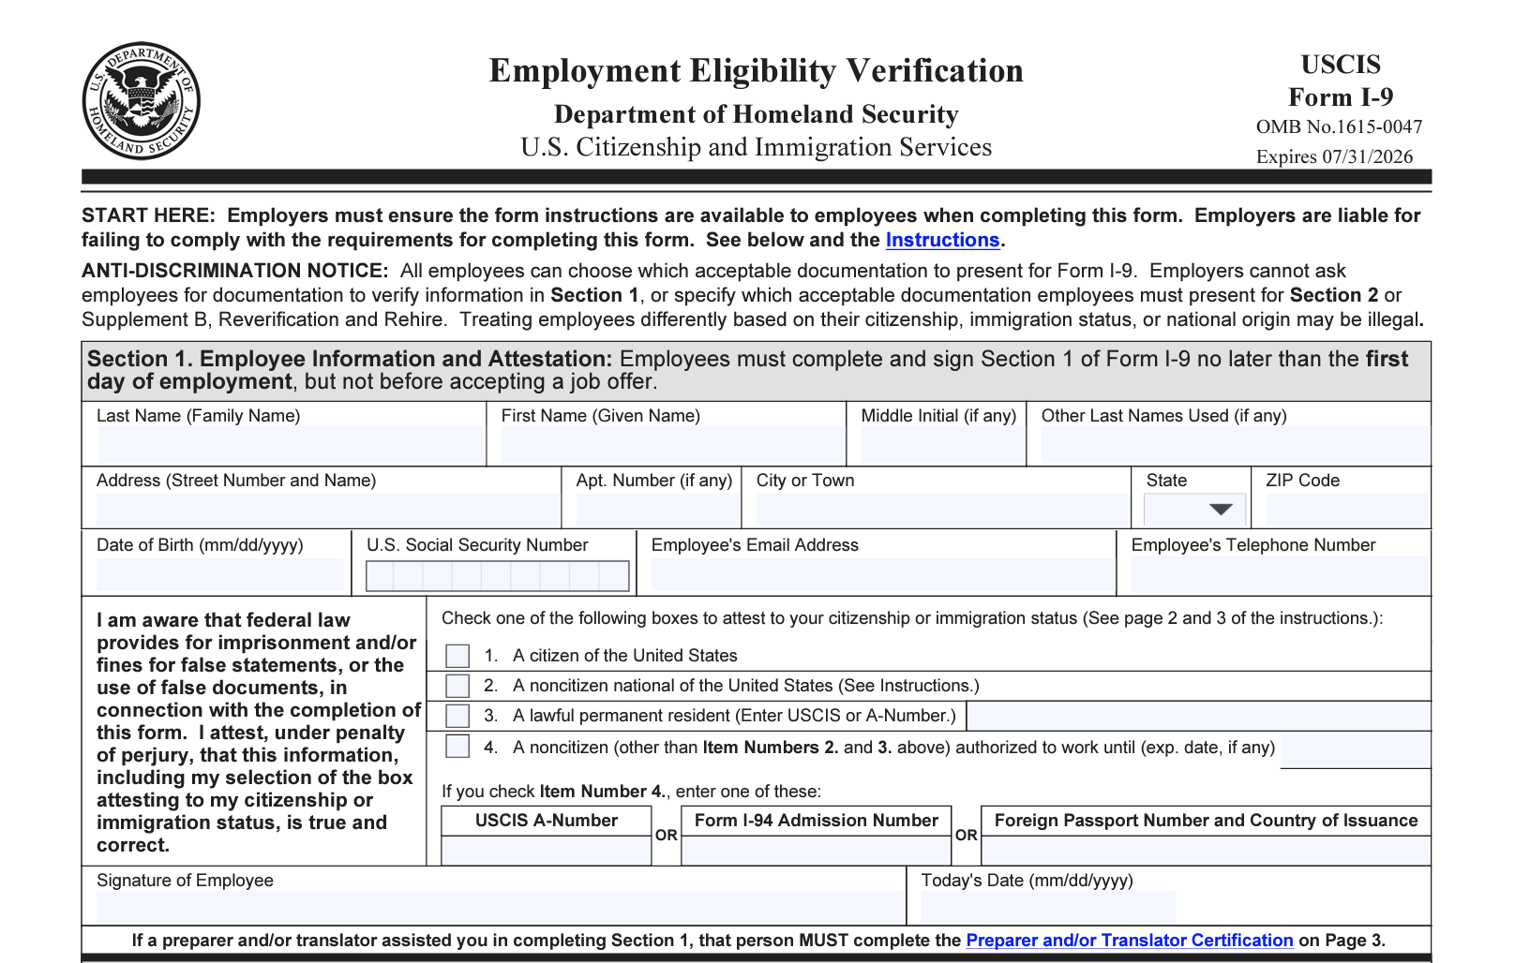
Stricter Enforcement of Immigration Laws
Preparing for an I-9 Audit
Before an audit:
Conduct an internal audit
Review your I-9 policy and processes
Understand common I-9 issues
Consider using E-Verify
Prepare a plan for responding to ICE
Upon receipt of an audit:
Initiate response plan
Immediately contact legal counsel
Collect and prepare documents for submission
Review findings and correct errors

Slide 18
Stricter Enforcement of Immigration Laws
Tips for an ICE Raid / On-Site Investigation
Contact Legal Counsel Immediately
Verify Agents’ Credentials: Confirm the agents' identity and official status.
Request and Review the Warrant and Scope of Investigation: Ask for a copy of the warrant and examine its details. Note there are differences between administrative and judicial warrants
Observe Without Interfering: Monitor the situation carefully but avoid obstructing the agents.
Steer Clear of Harboring Actions: Refrain from any behavior that could be interpreted as concealing individuals.
Keep Detailed Records: Document all events, interactions, and actions taken during the raid.
Inform Employees of Their Rights: Do not tell employees to refuse to speak, but you may remind them of their right to remain silent.

Slide 19
Major Changes at the NLRB
NLRB General Counsel Jennifer Abruzzo discharged
Appointed William Cowen as NLRB’s acting general counsel
Removed sitting NLRB Member Gwynne Wilcox
Judge ordered Wilcox be reinstated
Trump administration challenging the reinstatement order

Slide 20
Some Key GC Memoranda Rescinded
Pro-labor & employee positions that have been rescinded:
More expansive interpretation of conduct constituting “mutual aid or protection” and “concerted activity”
Unlawful labor practices (ULP) associated with electronic monitoring and algorithmic management of employees
Limitation on the use of confidentiality and non-disparagement provisions in severance agreements
Finding the proffer, maintenance and enforcement of noncompete agreements and “stay or pay” provisions to be ULPs
The expansion of remedies generally available for ULPs and settlements

Slide 21
Update on the Connecticut General Assembly

Slide 22
Notable Pending Employment Bills
Unemployment compensation benefits for striking workers
Predicative scheduling
Disclosure of pay and other information in job postings
Paid FMLA for bereavement leave
Expand workers’ compensation benefits to cover PTSD for workers who witness a serious bodily injury
Limitation on non-compete agreements

